Slide 1
CURRICULUM SUMMIT 2024
Joel Ebarb Executive Associate Dean
Renée Gaarder
Academic Program Manager
Carmen Morrow
Undergraduate Curriculum Coordinator

Slide 2
CLA Curriculum Summit 2024
Agenda
Welcome, Introductions, & Guests – Joel
Goals for the Curriculum Summit – Joel
Definitions – Carmen and Joel
CLA Proposal Process – Carmen
CLA PoS Update Process – Carmen
Stakeholders – Joel
CLA Curriculum Committee– Carmen
Q & A

Slide 3
CLA Curriculum Summit 2024
Introductions
Joel Ebarb – Executive Associate Dean
Renée Gaarder – Academic Program Manager
Carmen Morrow – Undergraduate Curriculum Coordinator
Kim Watley – Associate Registrar for Curriculum, Catalog, & Credit Evaluation
Holly Tittle-Hudson – Assistant Registrar
We would now like to have each of you introduce yourself!

Slide 4
CLA Curriculum Summit 2024
Goals for the Curriculum Summit
Detail new CLA Curriculog workflow
Review curriculum deadlines for AY 24-25
Explain CLA Plan of Study updating procedures for AY 25-26
Introduce AY 24-25 CLA Curriculum Committee
Reaffirm stakeholder responsibilities

Slide 5
CLA Curriculum Summit 2024
The platform formerly known as
Curriculog
is now
Modern Campus Curriculum

Slide 6
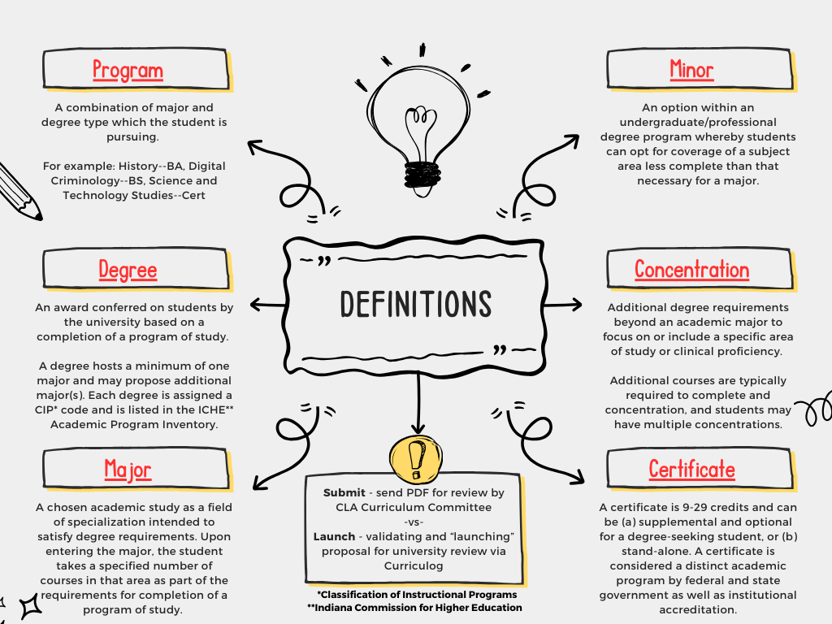
CLA Curriculum Summit 2024

Slide 7
CLA Curriculum Summit 2024
New Curriculum
PoS Updates
The building blocks: programs, degrees, majors, minors, concentrations, certificates, courses
The complete package: the combination of building blocks required to complete a degree/curricular component

Slide 8
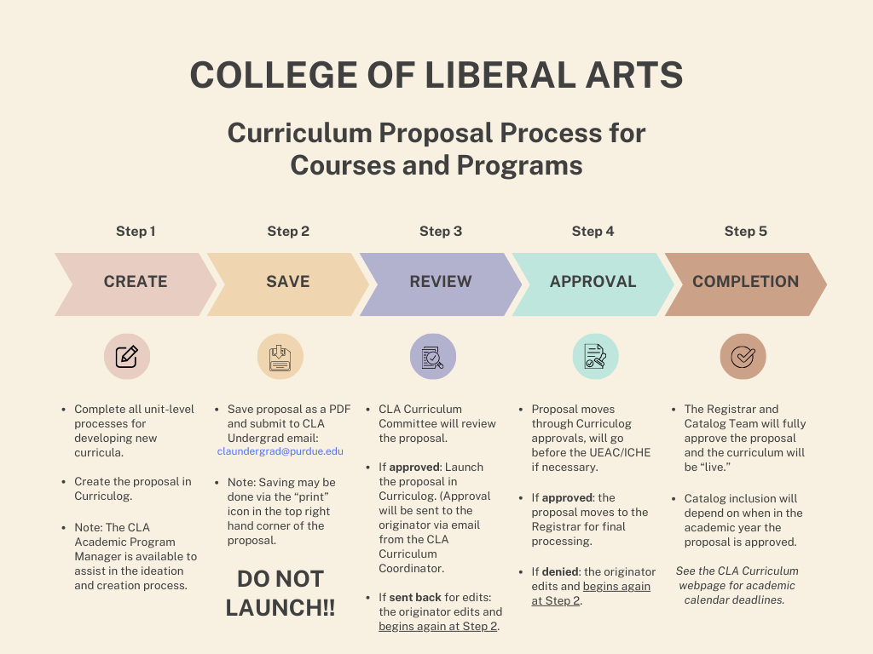
CLA Curriculum Summit 2024
Key terms used in academic proposals – including credit minimums or maximums for curricula – can be found in the Data Cookbook. Use the search bar or go to the Academic Proposals Collection.
Curriculog has embedded training guides and walkthroughs in the tool. Users can log in to purdue.curriculog.com and select “Walk Me Through” in the lower right corner to access Guided Training.
For additional training and support, please reach out to Renée Gaarder (rgaarder@purdue.edu) or Carmen Morrow (morrow23@purdue.edu).

Slide 9
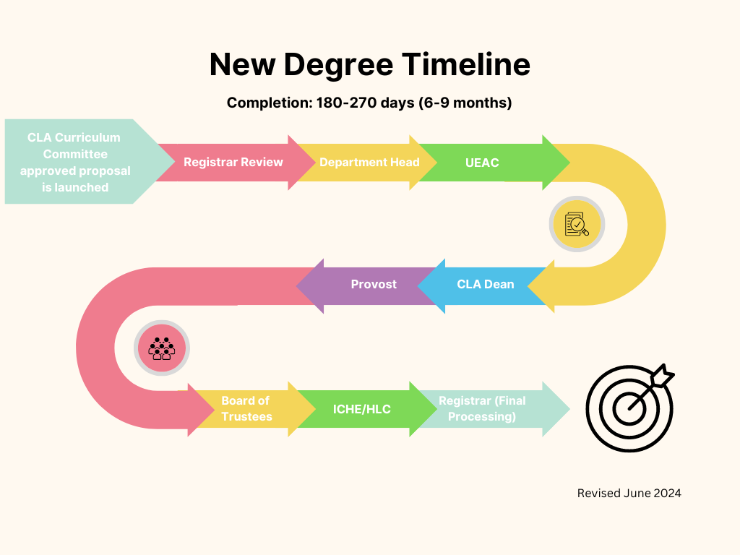
CLA Curriculum Summit 2024
CLA Proposal Workflow and Timeline – New Degree

Slide 10
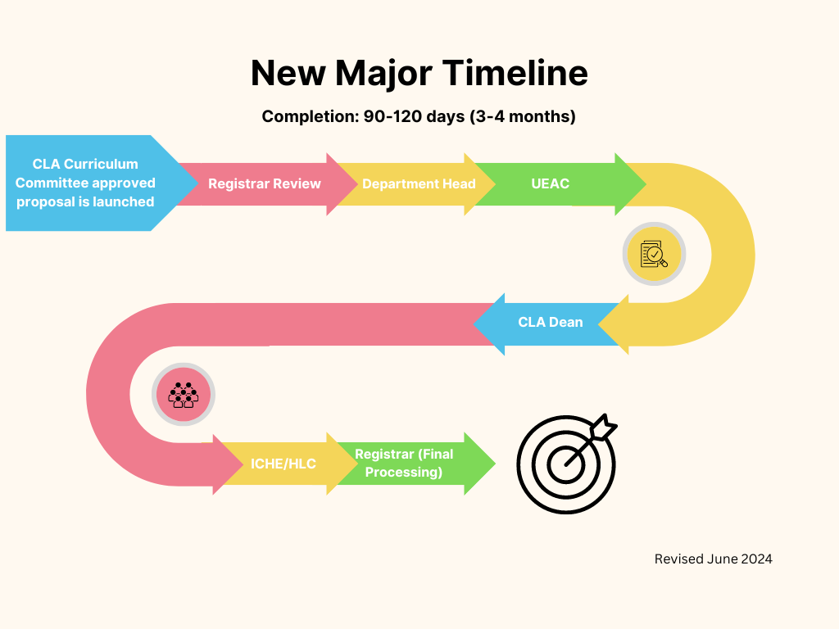
CLA Curriculum Summit 2024
CLA Proposal Workflow and Timeline – New Major

Slide 11
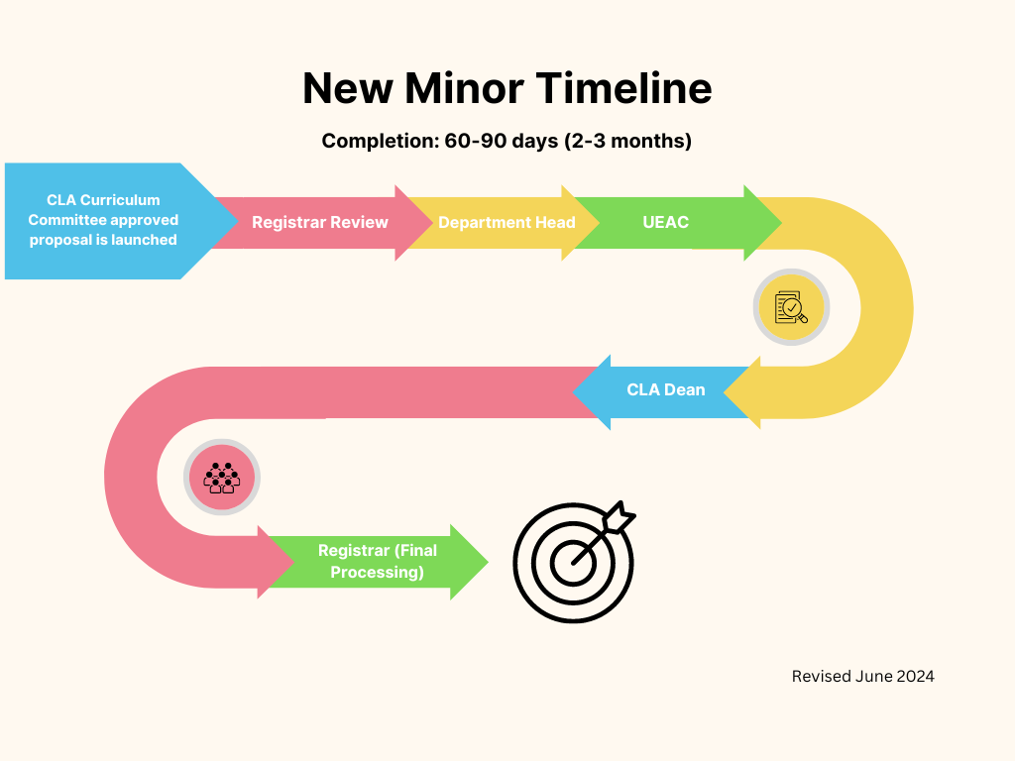
CLA Curriculum Summit 2024
CLA Proposal Workflow and Timeline – New Minor

Slide 12
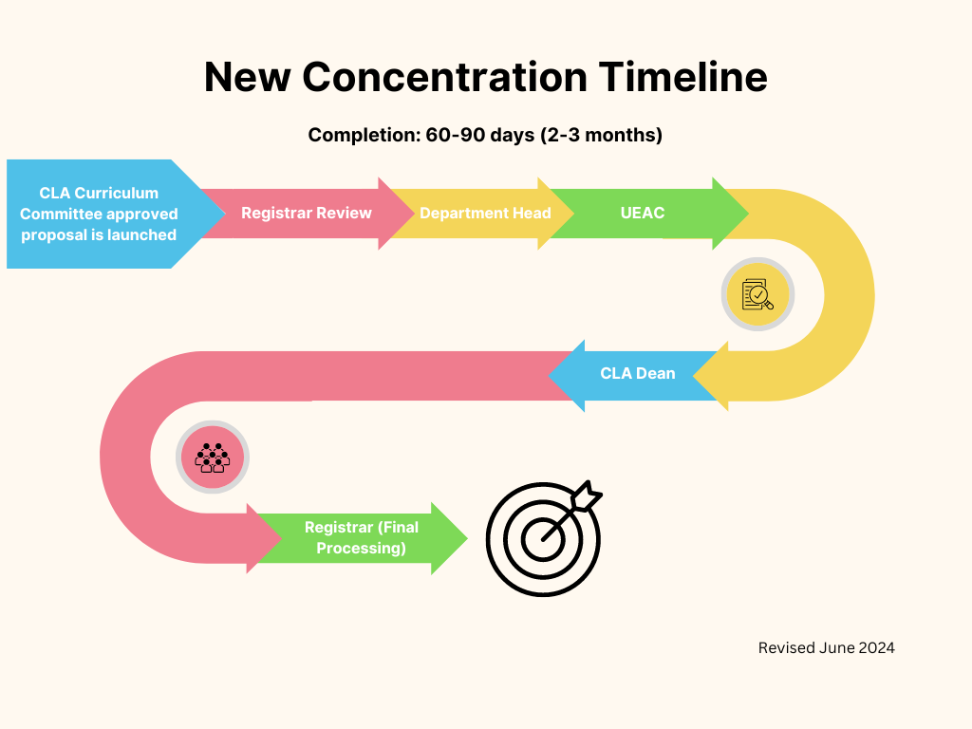
CLA Curriculum Summit 2024
CLA Proposal Workflow and Timeline – New Concentration

Slide 13
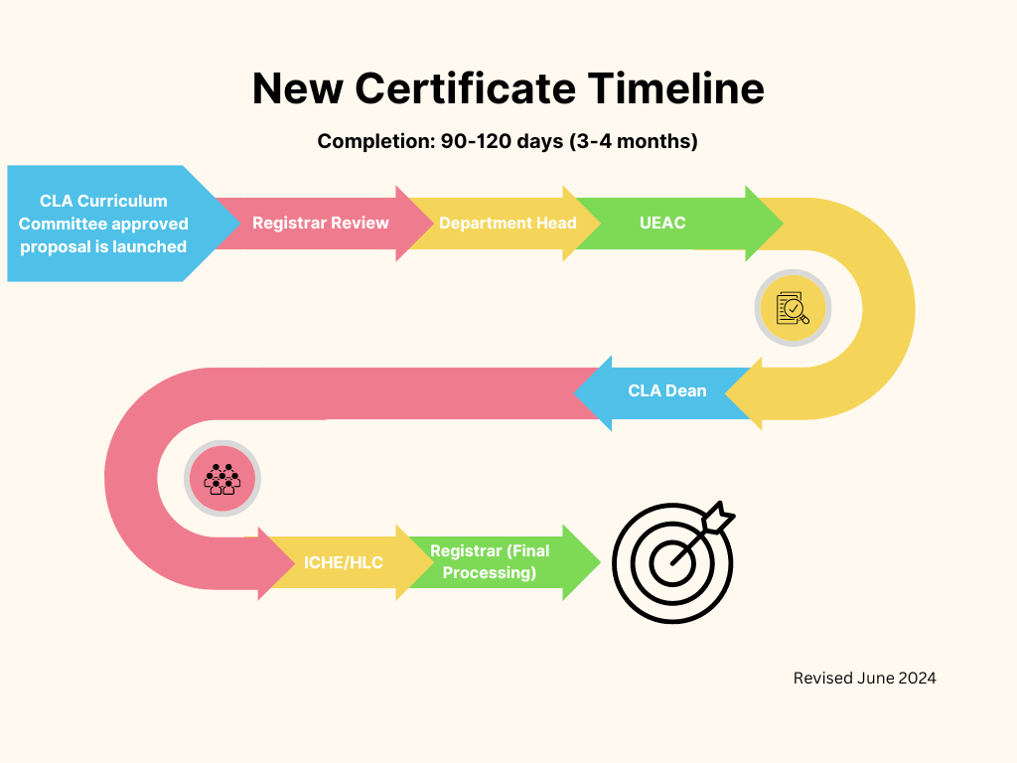
CLA Curriculum Summit 2024
CLA Proposal Workflow and Timeline – New Certificate

Slide 14
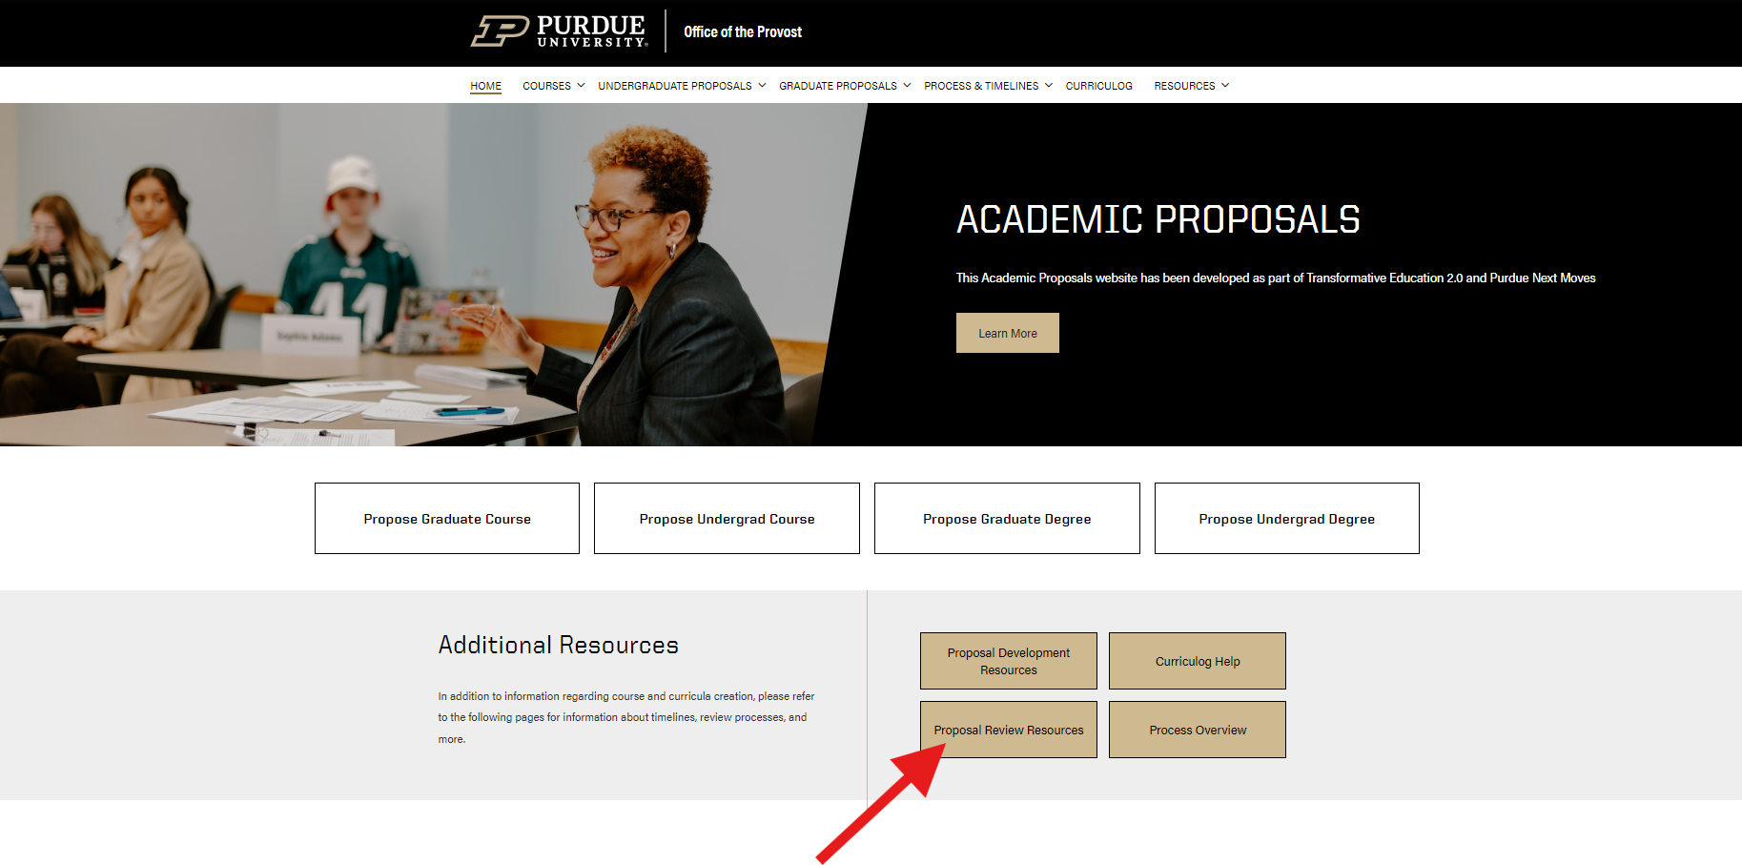
CLA Curriculum Summit 2024
Academic Proposals Website

Slide 15
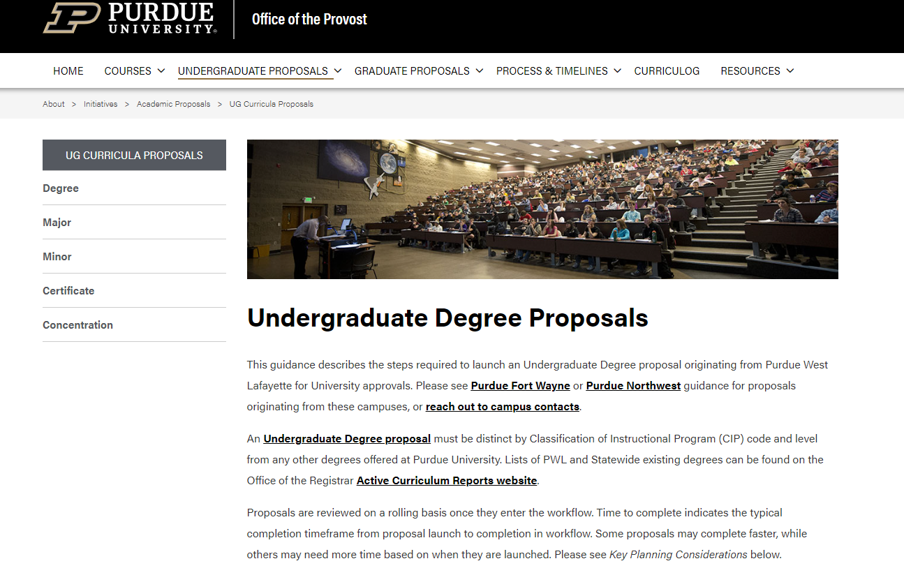
CLA Curriculum Summit 2024
UG Curricula Proposals

Slide 16
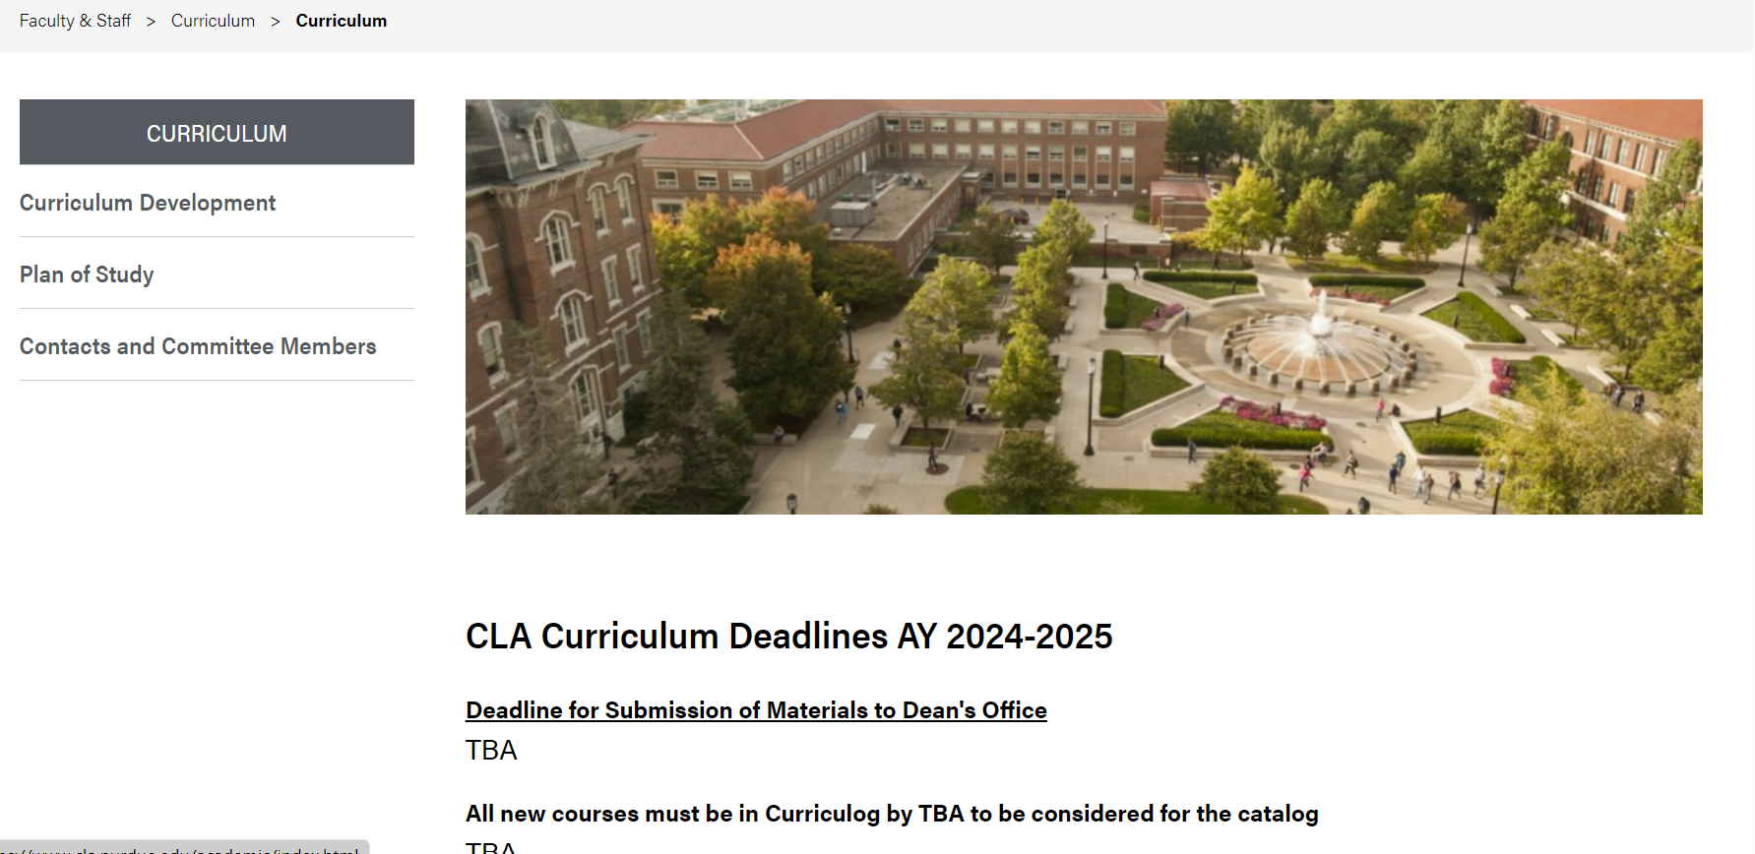
CLA Curriculum Summit 2024
CLA Curriculum Website
CLA.purdue > Faculty & Staff > under faculty resources, choose curriculum deadlines and Instructions

Slide 17
A lot has been covered so far. Let’s pause for any questions or comments before continuing.

Slide 18
CLA Curriculum Summit 2024
New Curriculum
PoS Updates
The building blocks: programs, degrees, majors, minors, concentrations, certificates, courses
The complete package: the combination of building blocks required to complete a degree/curricular component

Slide 19
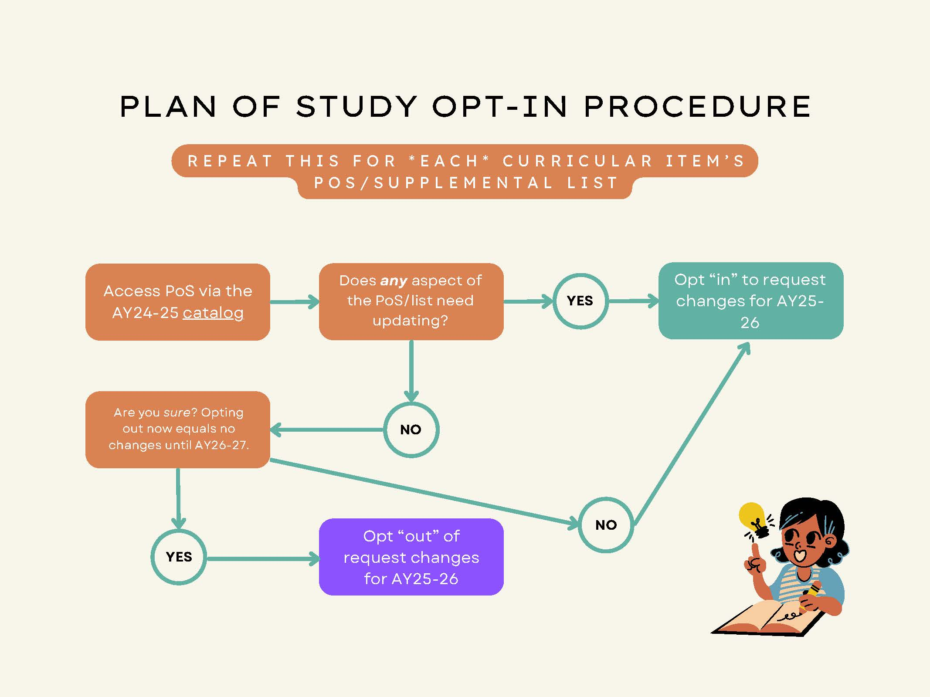
CLA Curriculum Summit 2024
Plan of Study Update Process – AY25-26
10/25: Opt-in changes due
12/13: Marked-up PDF due
2/17-3/14: Final review meetings
3/21: Final approvals due

Slide 20
CLA Curriculum Summit 2024
Responsibilities by Area for PoS Updates:
Unit - establish and follow all departmental curricula procedures; initiate all curriculum changes, edits, and reviews into Curriculog following established CLA protocols for curriculum changes; maintain and update Plan of Study templates and selective list annually.
Dean’s Office & Advising – provide curricular context and sustainability; schedule CLA Curriculum Committee meetings; provide notes and reports; identify potential conflicts and curricular impact inside and outside CLA; Plan of Study interactions.

Slide 21
CLA Curriculum Summit 2024
Stakeholders
Academic Units - schools, departments, units, and programs Head, Chair, Program Director, Unit Curriculum Committee, Schedule Deputies, Academic Advisors
College of Liberal Arts - Associate Dean for Undergraduate Education (Ebarb) Assistant to the AD for UG Ed & Curriculum Coordinator, CLA Curriculum Committee (chair),CLA Faculty Senate and CLA Educational Policy Committee
Office of the Registrar - University Registrar, Academic Services Contacts
Office of the Provost - Vice Provost for Teaching and Learning, Assistant Vice Provost for Academic Initiatives, Undergraduate Educational Affairs Council UEAC – Associate Deans from across campus
Indiana Commission for Higher Education (ICHE)

Slide 22
CLA Curriculum Summit 2024
CLA Curriculum Committee – AY24-25
ONE-YEAR TERM
Eli Craven (DAP)
Keith Shimko (POL)
Chris Lukasik (ENGL)
THREE-YEAR TERM:
Christie Sennott (SOC)
Yvonne Pitts (HIST)
Kali Rubaii (ANTH)
Jane Natt (COM), alternate
Dean’s Appointee (THREE-YEAR TERM):
Evan Westra (PHIL)

Slide 23
CLA Curriculum Proposal due dates:
Proposal PDF due to claundergrad@purdue.edu | CLA Curriculum Committee Meets
September 3rd | September 11th
October 1st | October 9th
November 4th | November 13th
December 2nd | December 11th
*All new courses must be in by January 6 to be considered for the AY25-26 catalog.

Slide 24
Questions or comments after the Curriculum Summit? Please contact claundergrad@purdue.edu

Slide 25
THANK YOU
Joel Ebarb
Executive Associate Dean
Renée Gaarder
Academic Program Manager
Carmen Morrow
Undergraduate Curriculum Coordinator

