Slide 1
PLaCE
Purdue Language and Cultural Exchange
Advisor Assembly
April 30, 2024
Suzanne Nicolas
Program Coordinator
PLaCE

Slide 2
Purdue Language and Cultural Exchange (PLaCE) supports those international students who learned English as a second language, and who will benefit from language and cultural support as they adjust to life at a U.S. university.
Our mission is to provide a strong instructional and assessment program. We help students develop the academic, linguistic and cultural competencies needed to participate in university life and to compete for graduate school and employment opportunities.
PLaCE

Slide 3
Why PLaCE?
The PLaCE requirement is based on the University Senate’s recommendation (via Resolution 15-13) and action approved by the Purdue Board of Trustees and set forth by the Office of the Provost on December 8, 2017.
The PLaCE program provides a required two-course sequence (SCLA 110 and SCLA 111) for all international undergraduate students based on their English proficiency scores.
PLaCE

Slide 4
Course Designation Change
Beginning with Summer 2024 – ENGL 110 and 111 will become SCLA 110 and 111.
Placement criteria remains the same.
Course content is the same.
Replacement grade equivalency for ENGL 110/111 is enabled.
SCLA 110 will stay a part of the UCC.
SCLA 111 will remain a humanities elective
PLaCE

Slide 5
Placement Protocol for International Students
SCLA 11000 1st semester SCLA 11100 2nd semester | SCLA 10100 or ENGL 10800
TOEFL total ≤100 | TOEFL total > 100 and TOEFL iBT writing ≥ 27
IELTS overall ≤ 7.5 | IELTS overall > 7.5 and IELTS writing ≥ 7.0
Duolingo (DET) ≤130 | Duolingo (DET) 135-160
“No TOEFL, IELTS, or DET Score” placement is in SCLA 11000. Exemptions will be determined in consultation with PLaCE testing staff and involves review of test scores, including the ACE-In test administered online during the summer and other compelling evidence of proficiency.
PLaCE

Slide 6
What happens next?
Qualifying students pre-enrolled in SCLA 110 and SCLA 111 by the Registrar’s office. Students with no proficiency scores are offered an online placement test in June to measure their proficiency and are placed based on those test scores.
Non-qualifying international students can add SCLA 110 or 111 on a case-by-case basis. Advisors who feel a student needs to be enrolled in SCLA 110 should request it on their course submission.
Students may be exempted from this PLaCE prerequisite by providing compelling evidence of advanced English language proficiency.
PLaCE

Slide 7
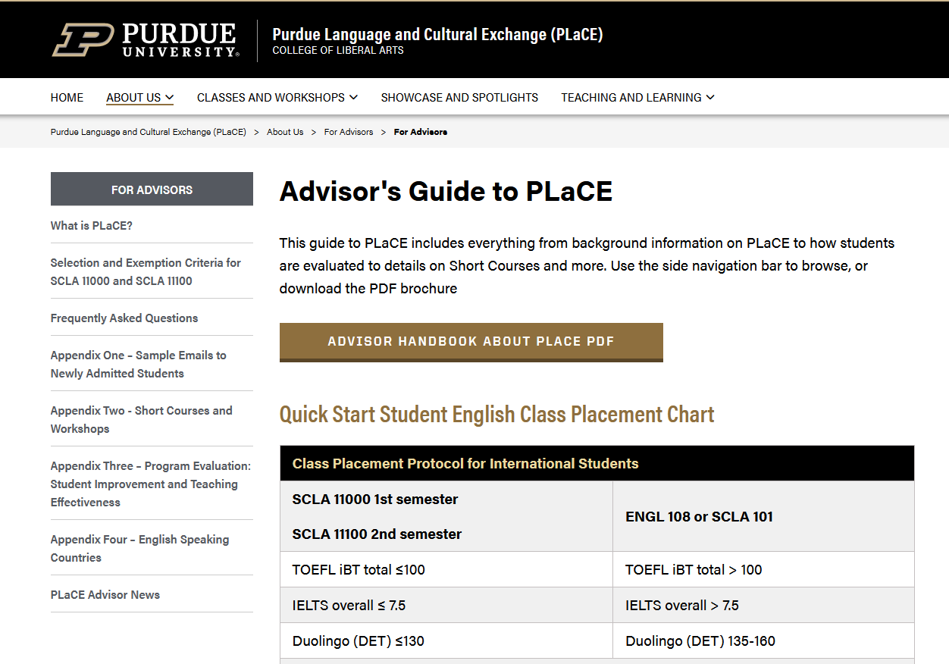
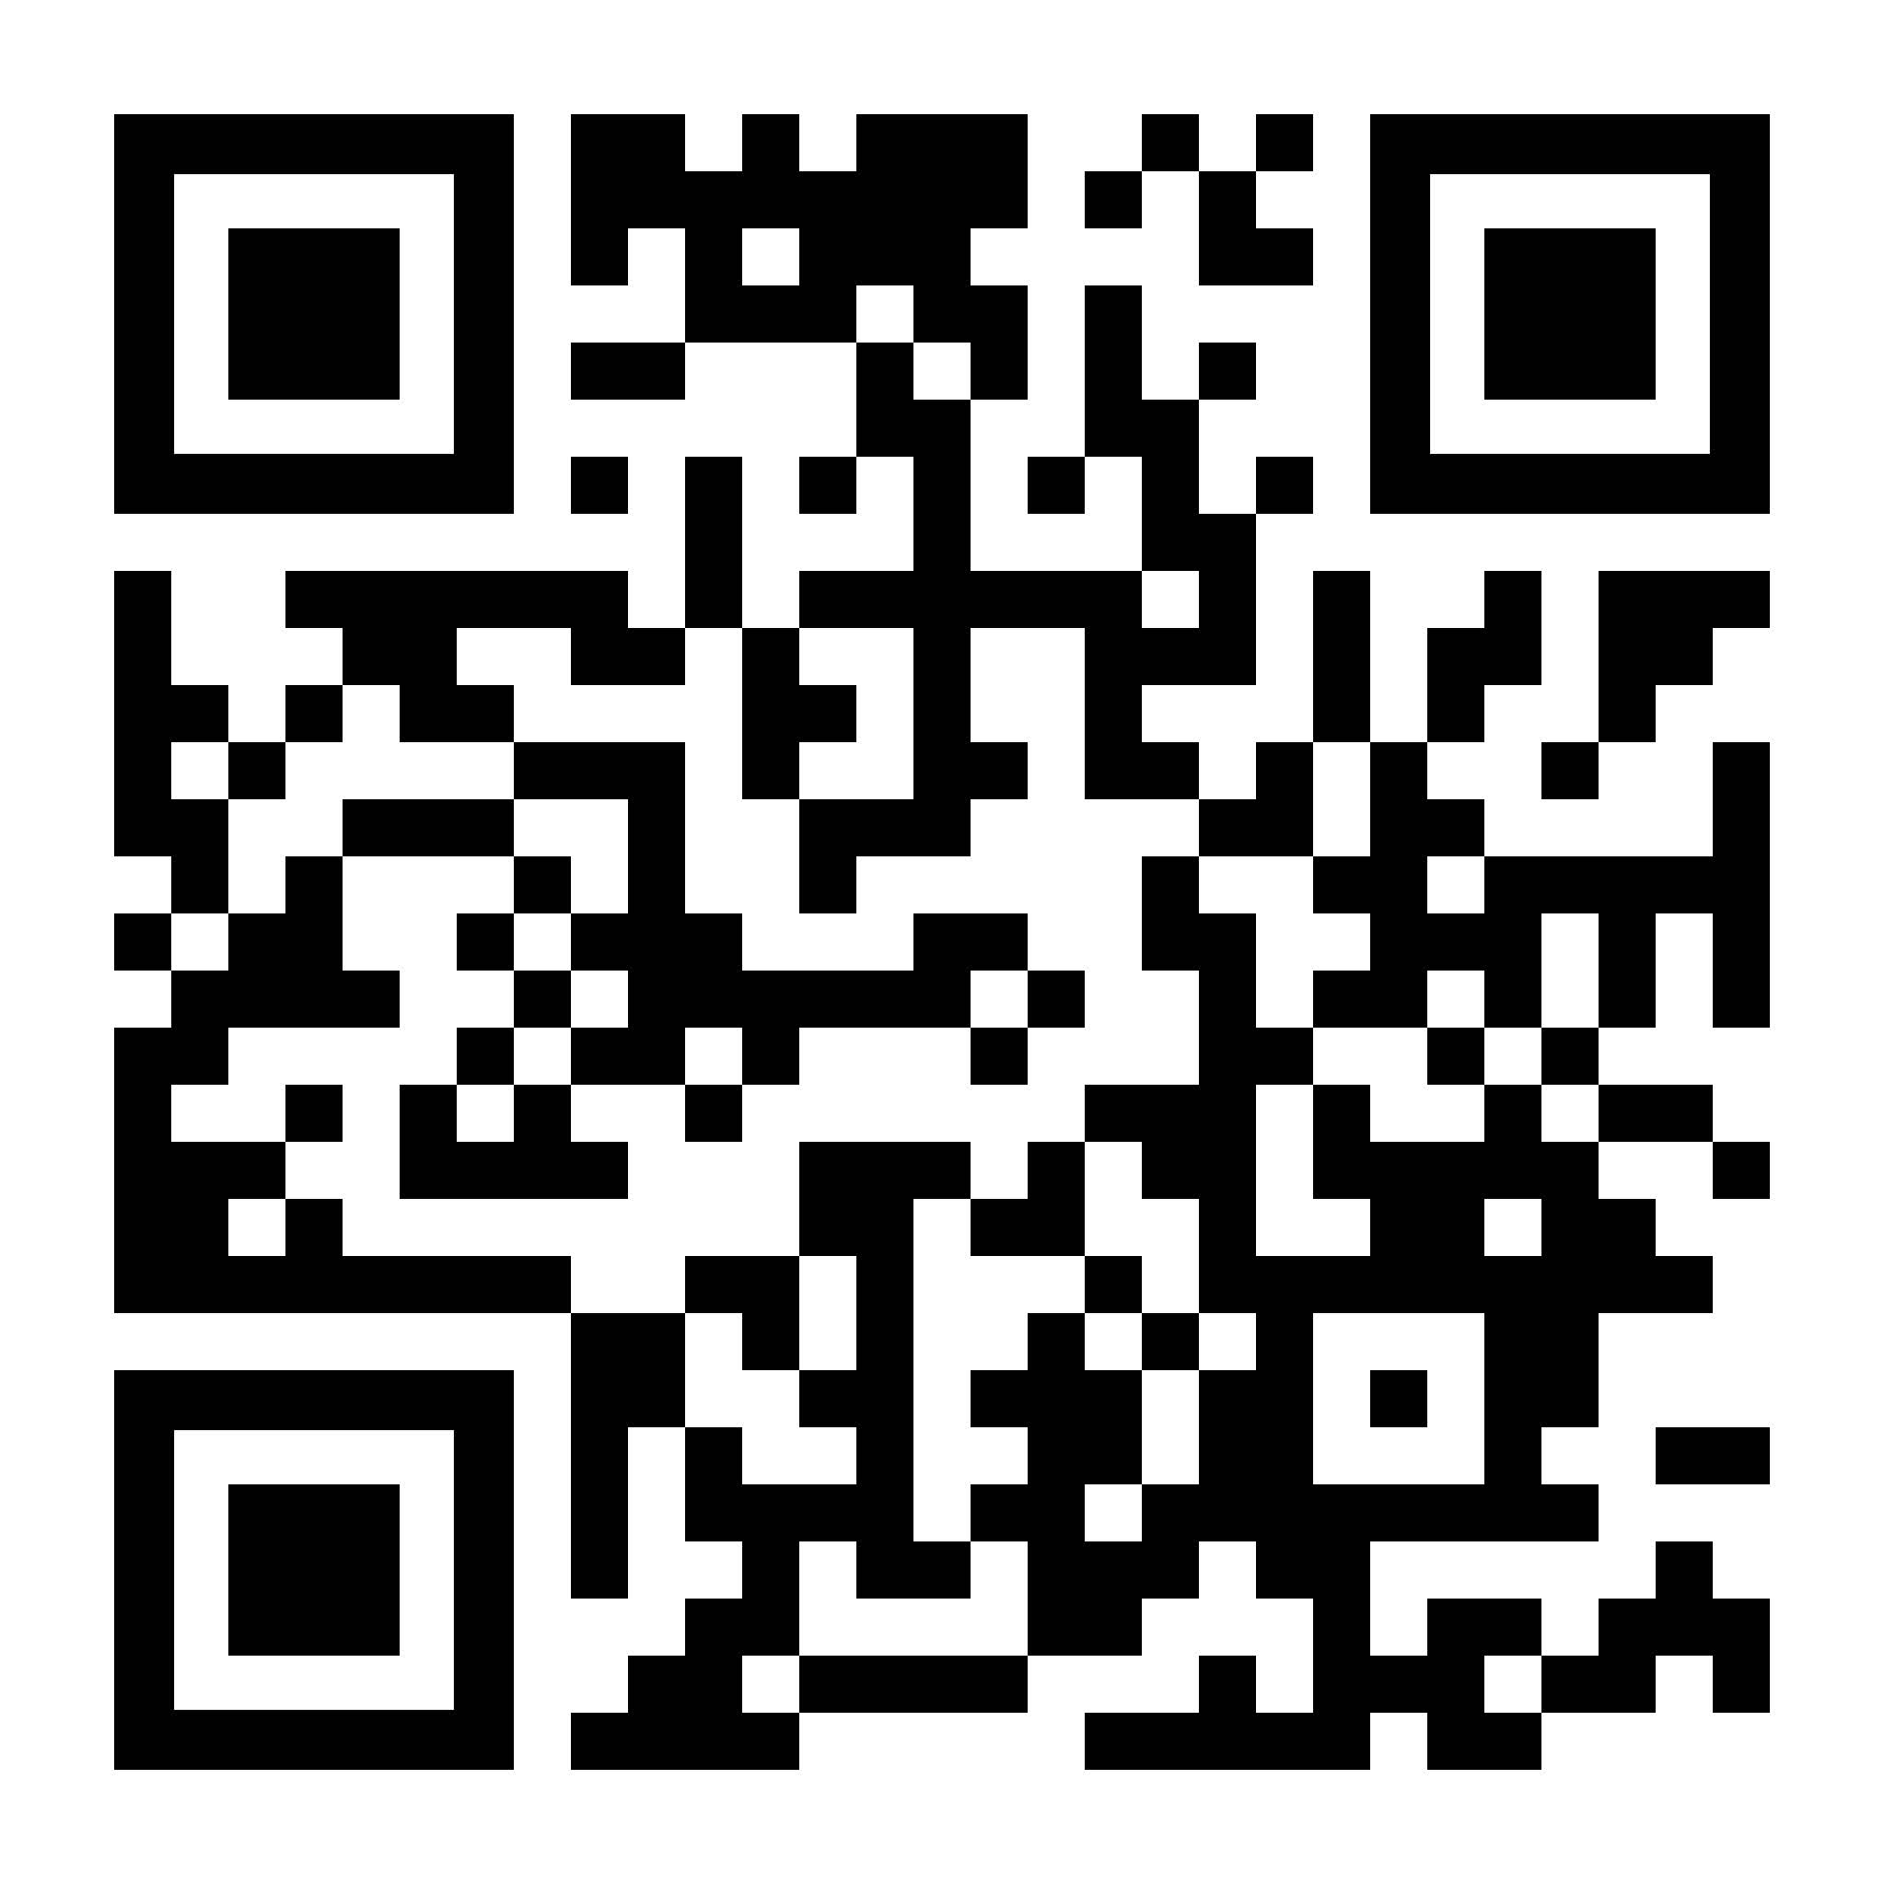
https://cla.purdue.edu/place/
PLaCE

Slide 8
THANK YOU!
Suzanne Nicolas PLaCE
Program Coordinator place@purdue.edu
YONG #833 https://cla.purdue.edu/place/
snicolas@purdue.edu Main Office: YONG 810
765-496-1090
PLaCE

